Slide 1
A Study Of
The Book Of Revelation
August 22, 2021

Slide 2
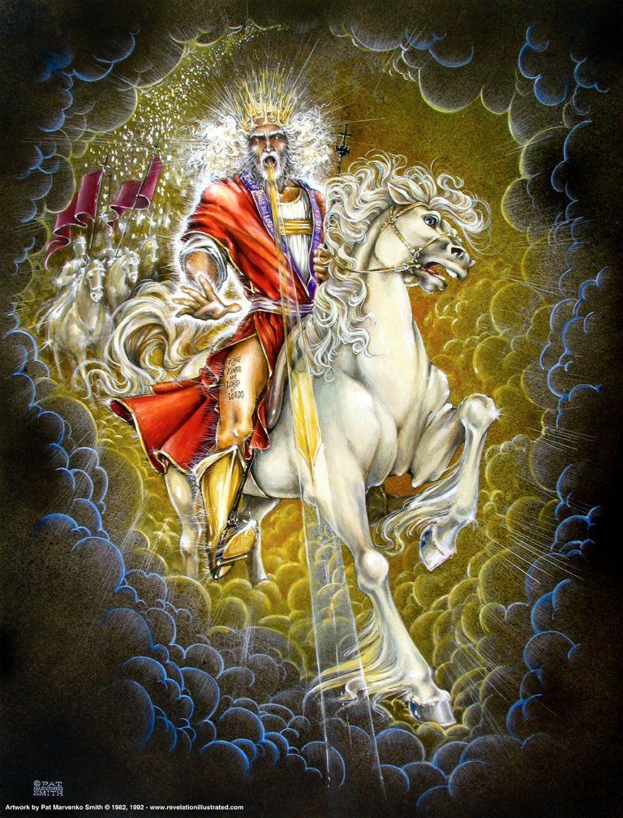

Slide 3

Revelation 19:17
Revelation 19
“And I saw an angel standing in the sun; and he cried with a loud voice, saying to all the birds that fly in mid heaven, Come (and) be gathered together unto the great supper of God;”

Slide 4
Revelation 19:18
Revelation 19
“that ye may eat the flesh of kings, and the flesh of captains, and the flesh of mighty men, and the flesh of horses and of them that sit thereon, and the flesh of all men, both free and bond, and small and great.”

Slide 5
God’s Great Supper
Revelation 19
In anticipation of the destruction of the dragon, beast, and false prophet – along with all who follow them (cf. 14:9-11)
By the advancing Christ and His host
Angels comes in to call the vultures that fly across the sky to come feed on the corpses of the defeated enemies of Christ and His church.
Highly figurative and symbolic – but a vivid picture nevertheless!

Slide 6
God’s Great Supper
Revelation 19
Note: The Great Supper of God (Defeat) in contrast the marriage feast of the Lamb (Victory)!
Outcome of the true Battle of Armageddon (16:16; Ezekiel 38 - 39:17-20) where Satan’s forces are gathered
  Enemies of God’s people.
Tables have been turned in history!
(cf. 13:4, 15)
Severity of God’s judgment that pits the Creature above the Creator (Romans 1:25)

Slide 7
Revelation 19:19
Revelation 19
Revelation 13:1.
“And I saw the beast, and the kings of the earth, and their armies, gathered together to make war against him that sat upon the horse, and against his army.”

Slide 8
Revelation 19:20
Revelation 19
Revelation 13:1.
“And the beast was taken, and with him the false prophet that wrought the signs in his sight, wherewith he deceived them that had received the mark of the beast and them that worshipped his image: they two were cast alive into the lake of fire that burneth with brimstone:”
Revelation 13:11; 16:13; 19:20
Revelation 14:11.
Revelation 14:9ff
Harlot burned with fire! Revelation 18:8
cf. Daniel 7:9-11

Slide 9
Revelation 19:21
Revelation 19
NOTE: “the rest” were not cast into the “lake of fire” until 20:11-15 … The final judgment!
“and the rest were killed with the sword of him that sat upon the horse, (even the sword) which came forth out of his mouth: and all the birds were filled with their flesh.”

Slide 10
Last Ditch Attack …
Revelation 19
Army of evil and its defeat
All the allied forces of evil
The beast (civil persecuting power) Sea Beast (Daniel 7:9-12)
Kings of the earth and their armies
False prophet – earth beast (false religion)
Victory of Christ is swift, complete, and sure!
Rome’s future prophecy seen in ruins!

Slide 11
Final Outcome
Revelation 19
Dragon and his allies seemed invincible
Fate of the two beasts “Cast into the lake of fire”
Results of Armageddon
666 utter defeat!
“The rest” “Cast into the lake of fire” (second death) (20:10, 14-15; 21:8)
By being alive a sorer punishment!
Lake represents their utter defeat.

